Slide 1

1.0 Data Science With Python Introduction
© London Academy of IT, www.londonacademyofit.co.uk

Slide 2
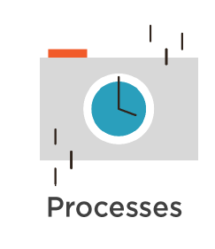

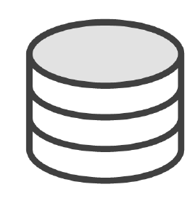


Data Science With Python

Slide 3
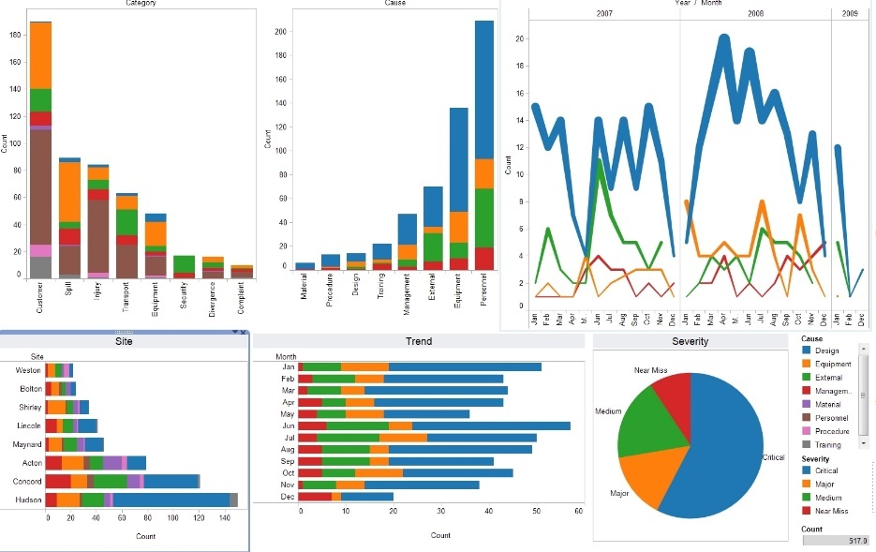

Data Science With Python

Slide 4
What is Data Science ?
“Set of fundamental principles that guide the extraction of knowledge of data”

Slide 5
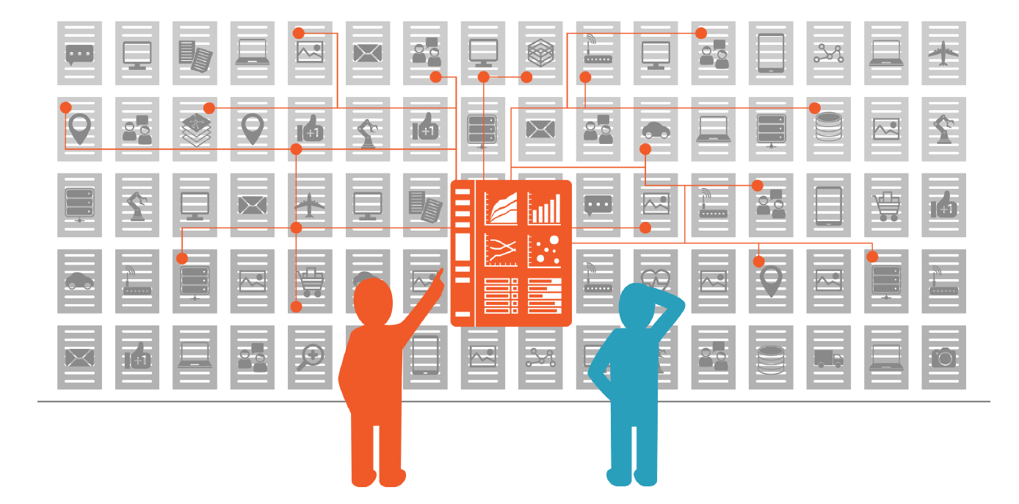
Data Science With Python

Slide 6
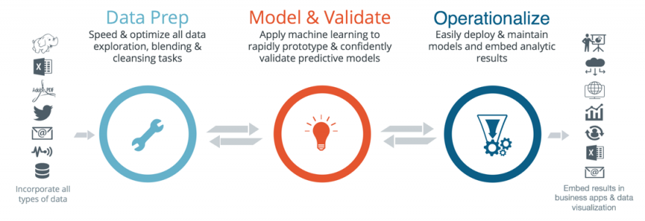
What you will learn in this course ? – Life cycle

Slide 7
What you will learn in this course ?
Data science project cycle
Exercises
Case study
Best practises
Tips & tricks

Slide 8

About case study: Titanic Disaster
Both simple and complex example
No business knowledge is required

Slide 9
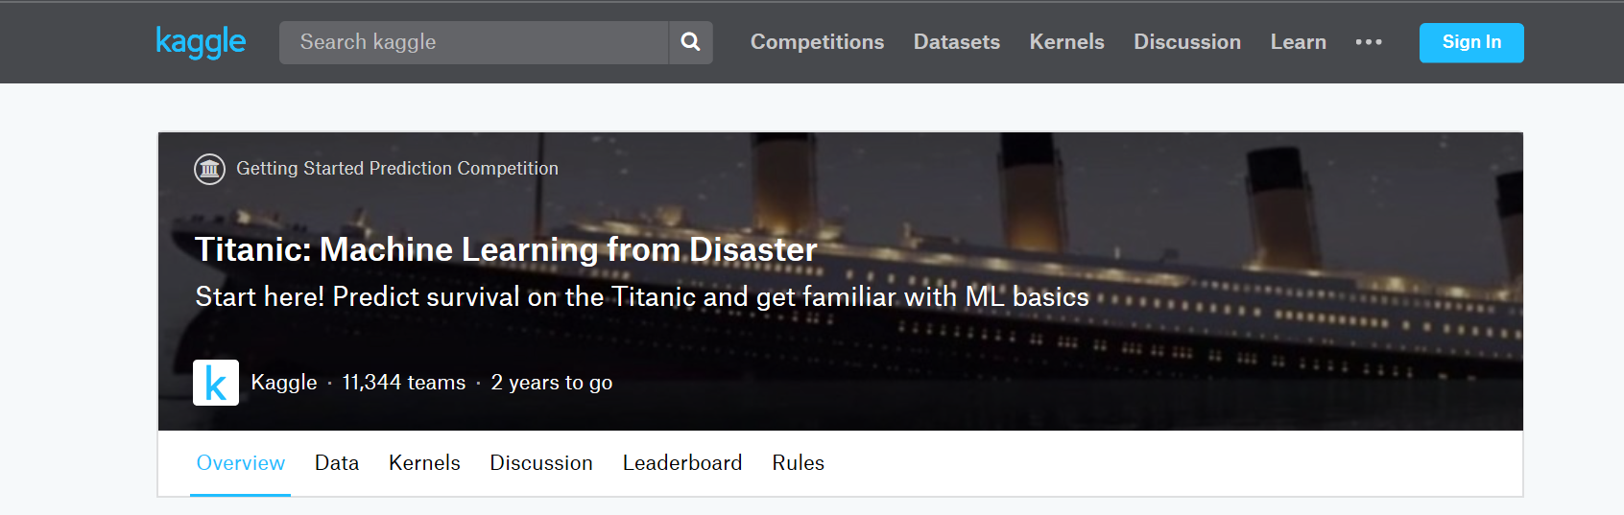
About case study: Titanic Disaster

Slide 10
Course Pre-requisites
Basic Python Knowledge
High school maths

Slide 11
Why Python for Data Science
Tools & libraries
Easy and simple
Active community
Scalability

Slide 12

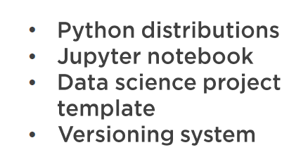
Data Science With Python – Course outline

Slide 13

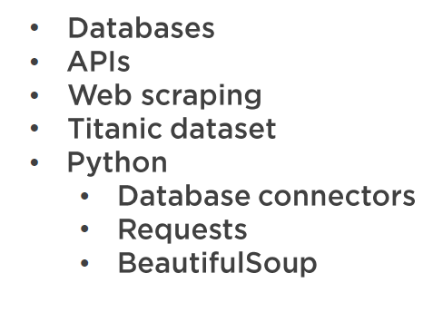
Data Science With Python – Course outline

Slide 14

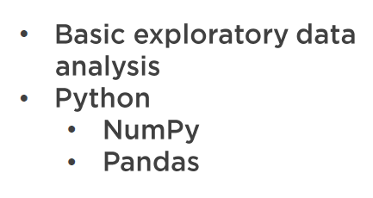
Data Science With Python – Course outline

Slide 15

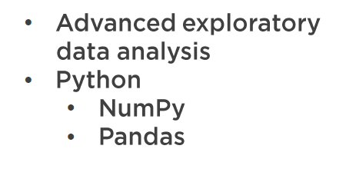
Data Science With Python – Course outline

Slide 16

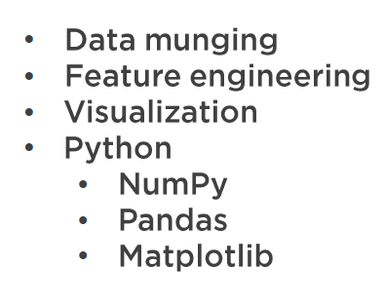
Data Science With Python – Course outline

Slide 17

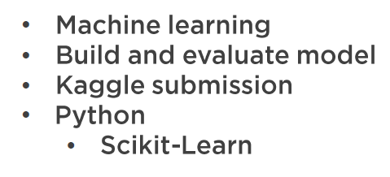
Data Science With Python – Course outline

Slide 18
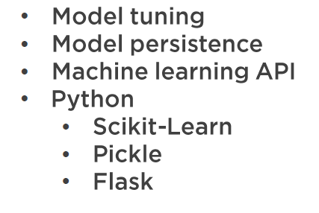
Data Science With Python – Course outline

